Slide 1
Name:- Eashan Verma Student Number:- 24251111 Course:- MSc Data Science and Analytics Course Code:- CS621C Course Name:- Spatial Databases

Slide 2

Exploring Key Services for International Students in Manchester
This project focuses on the universities in Manchester and aims to provide valuable insights for international students studying in these institutions. The core objective is to map essential services, such as medical shops and Indian restaurants, located near these universities. Additionally, the project will highlight how students can conveniently access these destinations using public transport, specifically the bus network. The work will involve analyzing data from various bus stops across Manchester, Greater Manchester, and the iconic Old Trafford area, ensuring that international students can navigate the city with ease while discovering its rich cultural offerings.

Slide 3
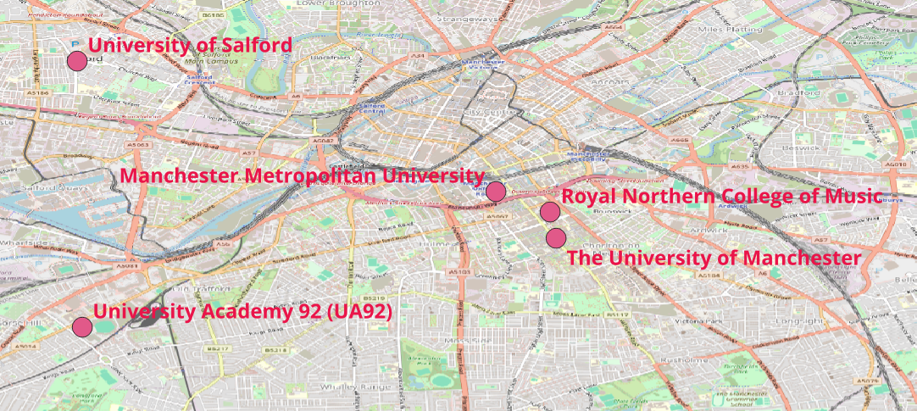
Universities in Manchester
- Represents Universities in Manchester

Slide 4
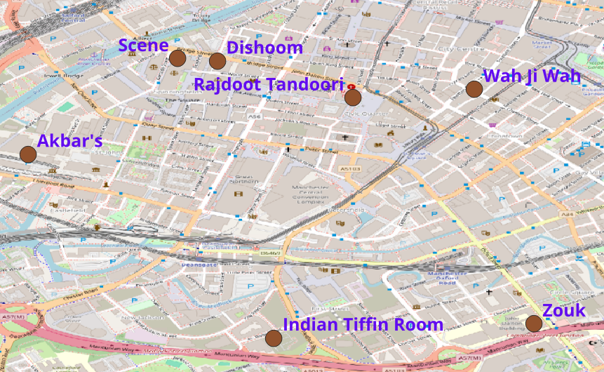
Indian Restaurants in Manchester
- Represents Indian Restaurant in Manchester

Slide 5
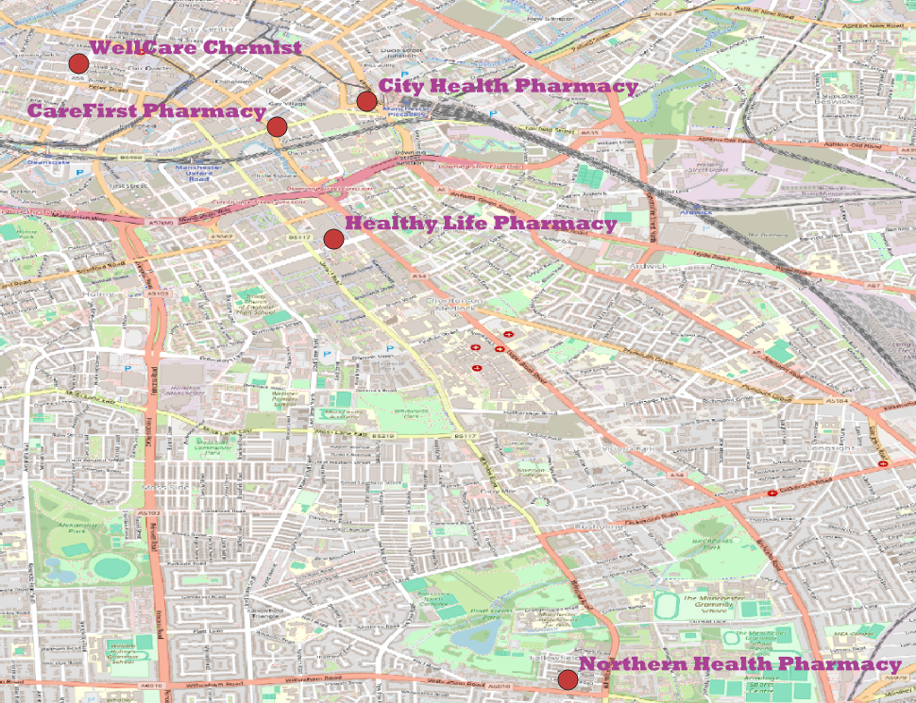
Pharmacy/ Medical Shops in Manchester
- Represents Medical Shops in Manchester

Slide 6
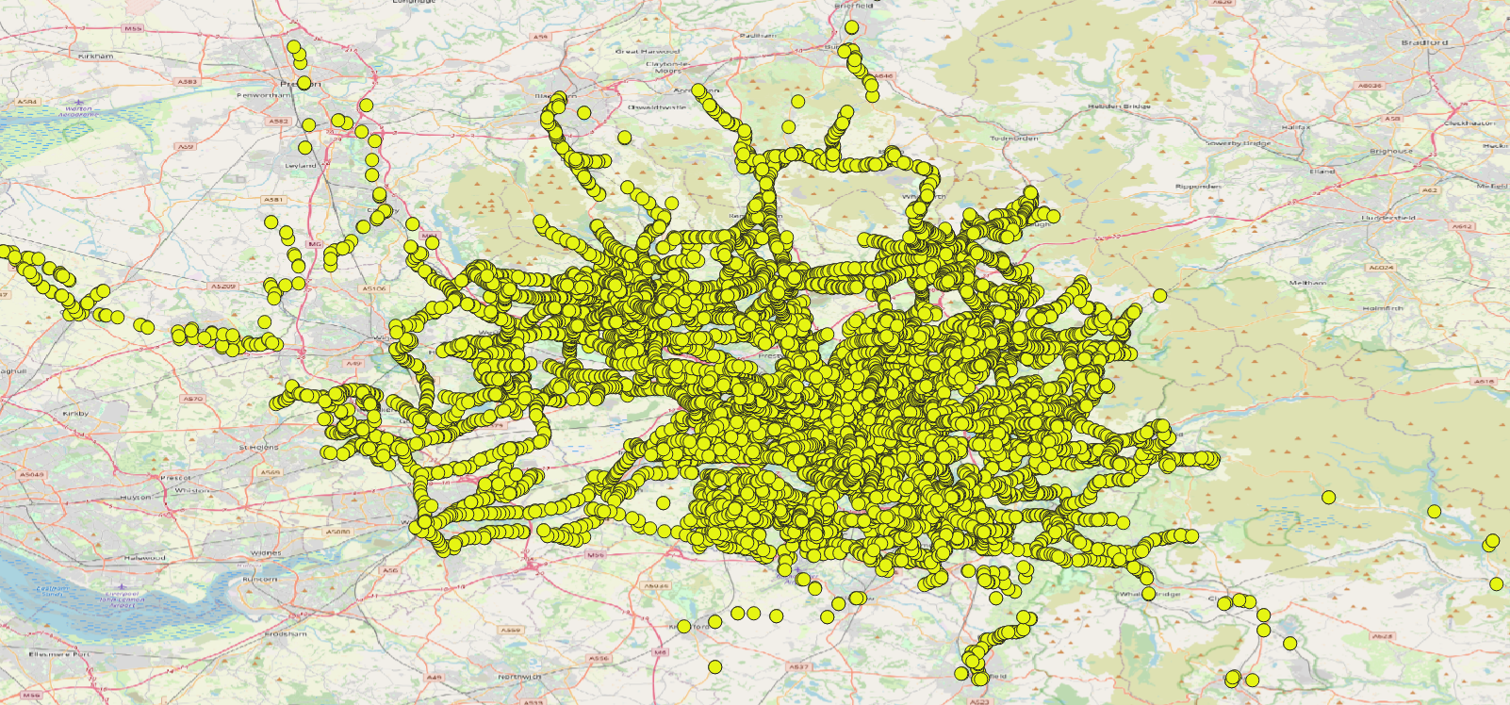
Bus Stops in Manchester
- Represent Bus stops in Manchester

Slide 7

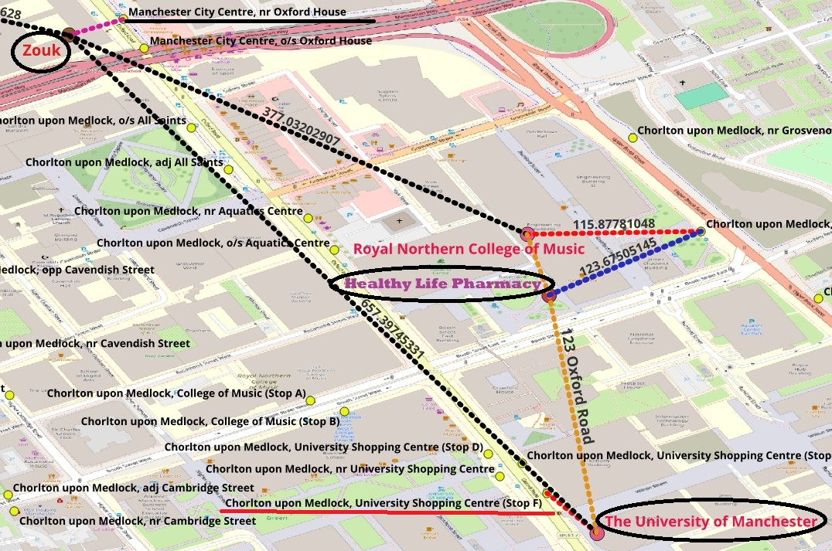
The University of Manchester
The University of Manchester is renowned for its significant contributions to science and technology and has a rich academic heritage, boasting 25 Nobel laureates among its current and former staff and students. The university has a diverse student body, with more than 44,000 students, including a substantial international community. Approximately 1,500 students from India are currently studying at the university, reflecting its global appeal. In the Image attached, we can see the bus stop which is the nearest to the University campus is located at Chorlton upon Medlock, University Shopping Centre (Stop F) at the distance of 55.44 meters, barely at a walking distance. The Indian Restaurant Zouk is the nearest from the campus and to reach there the student can take the bus to the nearest stop to Zouk which is Manchester City Centre, nr Oxford House at the distance of 40.51 meters. Moreover, in a medical emergency, students can visit the nearest pharmacy which is Healthy Life Pharmacy, 123 Oxford Road situated at a walking distance of 267.51 meters from the campus.

Slide 8

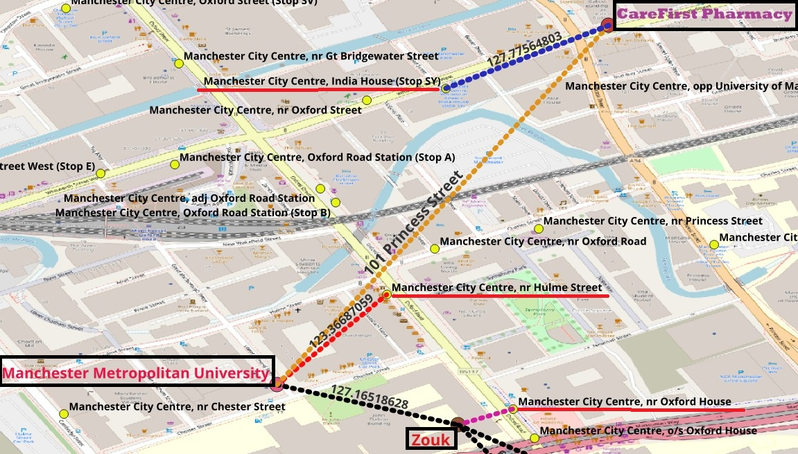
Manchester Metropolitan University
Manchester Metropolitan University (MMU) is recognized for its extensive degree apprenticeship programs, being the top-rated university for degree apprenticeships and holding a Grade 1 Outstanding rating from Ofsted. MMU has a diverse student body, with international students comprising 18% of the total enrollment. The university welcomes students from over 130 different countries, including India. In the Image attached, we can see the bus stop which is the nearest to the University campus located at Manchester City Centre, nr Hulme Street at the distance of 123.36 meters. The Indian Restaurant Zouk is the nearest from the campus located at the walking distance of 127.16 meters. Moreover, in a medical emergency, students can visit the nearest pharmacy which is CareFirst Pharmacy, 101 Princess Street at a distance of 454.67 meters and to reach there the student can take the bus to the nearest stop to the pharmacy which is Manchester City Centre, India House (Stop SY) at the walking distance of 127.77 meters.

Slide 9

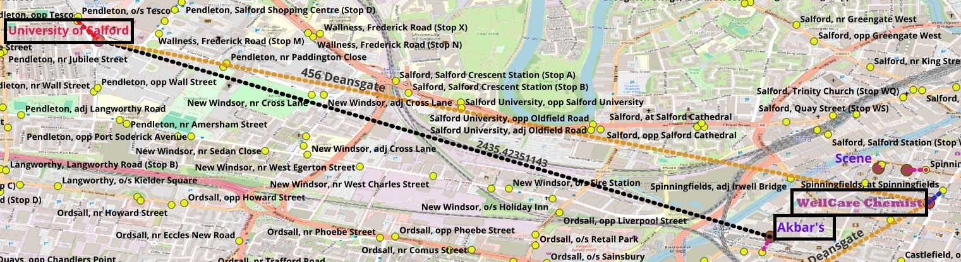
University of Salford
The University of Salford, located in Salford, Greater Manchester, England, is renowned for its strong emphasis on industry collaboration and practical education. International students make up approximately 11% of the student body. As the image states, University of Salford is a bit away from the amenities. To the nearest Indian restaurant that is Akbar’s, at the distance of 2435.4 meters, the student needs to take the bus from the nearest bus stop from campus that is Pendleton, opp Tesco, at 124.21 meters and drop down to the nearest bus stop to Akbar’s that is Castlefield, o/s Science Museum, at the distance of 89.81 meters. Similarly, To the nearest Pharmacy that is WellCare Chemist, 456 Deansgate at the distance of 2841.2 meters, the student needs to take the bus from the nearest bus stop from campus and drop down to the nearest bus stop to Pharmacy that is Spinningfields, at the distance of 81.84 meters.

Slide 10

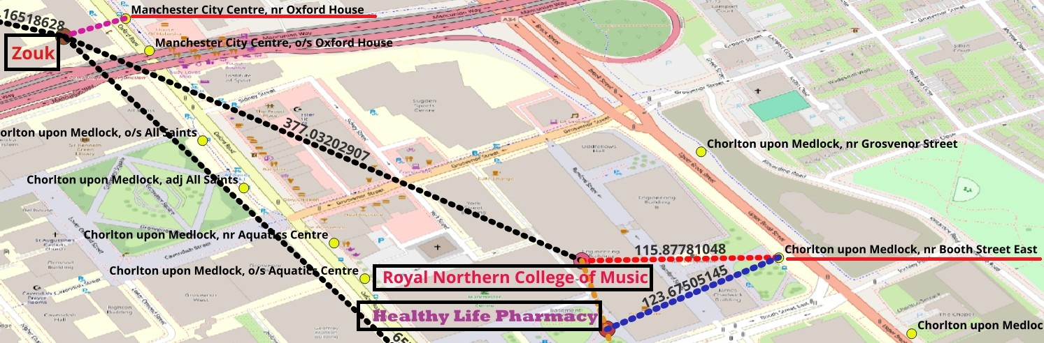
Royal Northern College of Music
The Royal Northern College of Music (RNCM), is a prestigious conservatoire renowned for its world-class music education and performance opportunities. It consistently ranks among the top institutions for music globally, sharing the No. 5 position with New York's Juilliard School in the QS University World Rankings. With a diverse student body of approximately 770 students from over 50 countries, international students comprise about 22% of the population. From the image attached, it can be clearly stated that the students of Royal Northern College of Music are the luckiest as all the amenities are within the walking distance to them from the campus. The Healthy Life Pharmacy, 123 Oxford Road is at the distance of 69.52 meters from the campus whereas Zouk, The Restaurant is at the distance of 377.03 meters only. Moreover, the nearest bus stop from the campus is just at 115.87 meters that is Chorlton upon Medlock, nr Booth Street East.

Slide 11

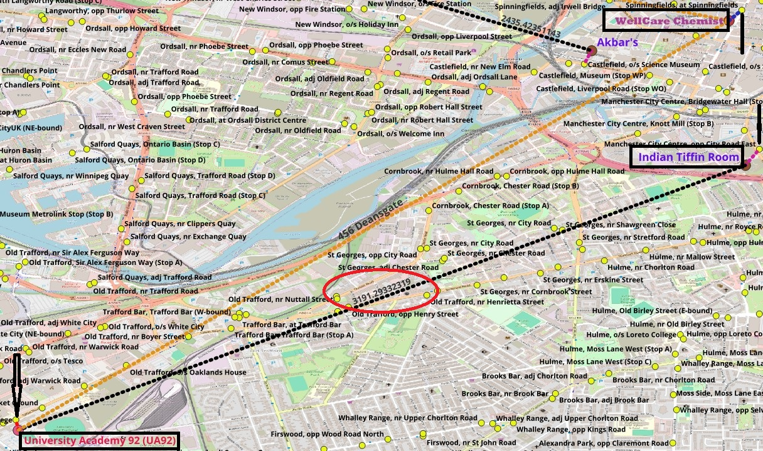
University Academy 92 (UA92)
University Academy 92 (UA92), located in Old Trafford, Manchester, England, is a higher education institution founded in 2017 and is renowned for its innovative approach to education, emphasizing character development alongside academic learning, and strong industry partnerships with organizations like Microsoft and KPMG. UA92 has a diverse student body, including international students from various countries. From the image, we can conclude that just like the University of Salford, University Academy 92 is also distant from the amenities. To get to the nearest Pharmacy that is WellCare Chemist, 456 Deansgate at the distance of 3704.13 meters, student needs to board the bus from the nearest bus stop from the campus that is Old Trafford, opp Trafford College at the distance of 67.45 meters to the nearest bus stop to the pharmacy that is Spinningfields, at the distance of 81.84 meters. Moreover, for the Indian Tiffin Room, the nearest Indian Restaurant at the distance of 3191.29 meters from the campus, student needs to board the bus to Manchester City Centre, opp City Road East which is 115.18 meters away from the restaurant.

Slide 12
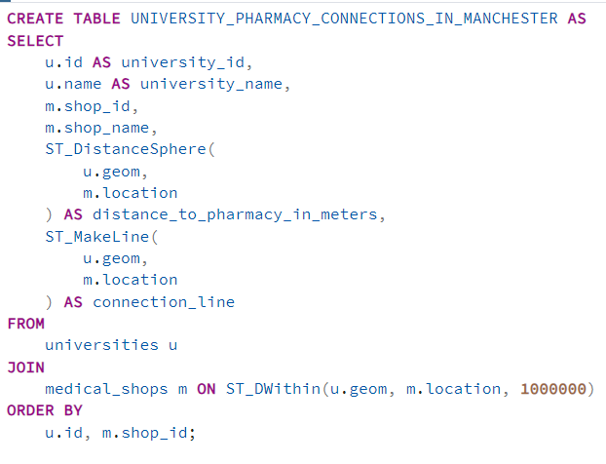
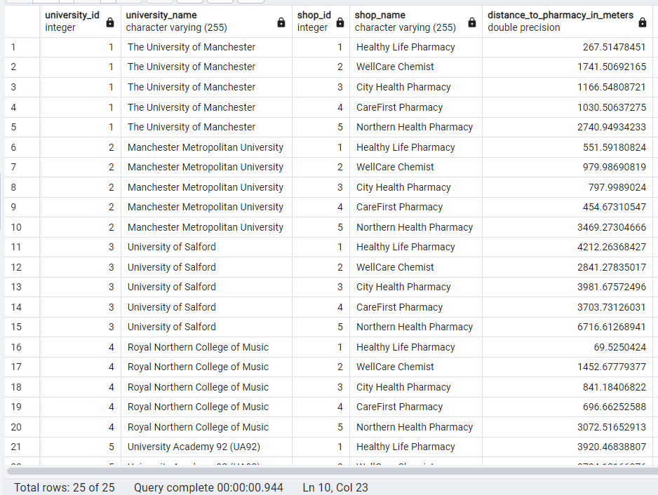
This Query will show distance between all the pharmacies and all the universities in Manchester.

Slide 13
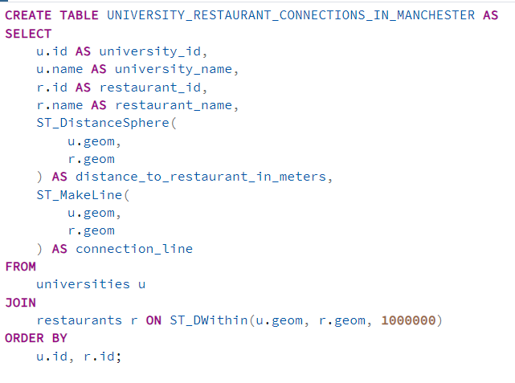
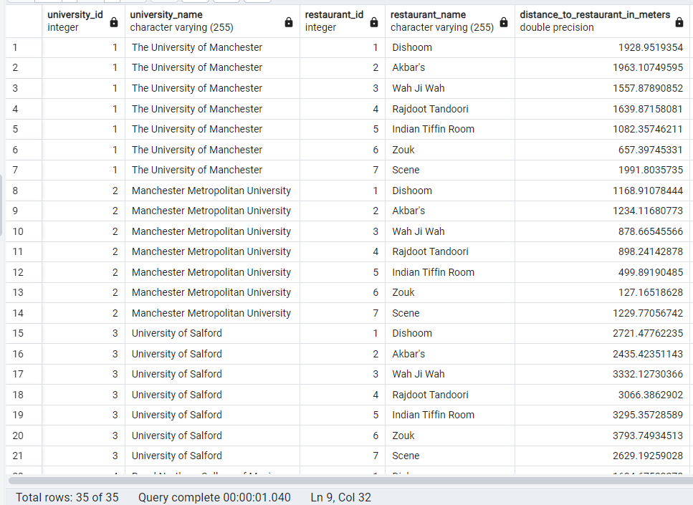
This query will show the distance between all the restaurants and all the universities.

Slide 14

Thankyou For your Valuable Time.

